Slide 1




SCOPE: Optimizing Key-Value Cache Compression in Long-context Generation
Jialong Wu¹, Zhenglin Wang¹, Linhai Zhang², Yilong Lai¹, Yulan He^{2,3}, Deyu Zhou¹
¹Southeast University ²King’s College London ³The Alan Turing Institute
In Proceedings of the 63rd Annual Meeting of the Association for Computational Linguistics (ACL 2025)
Notes:
Good morning everyone. I am Jialong Wu. I’m very happy to be here today to present our work, “SCOPE: Optimizing Key-Value Cache Compression in Long-context Generation”. This is a joint work between Southeast University and KCL.
In this presentation, I will walk you through the motivation, method, experimental results, and future work of our study.

Slide 2
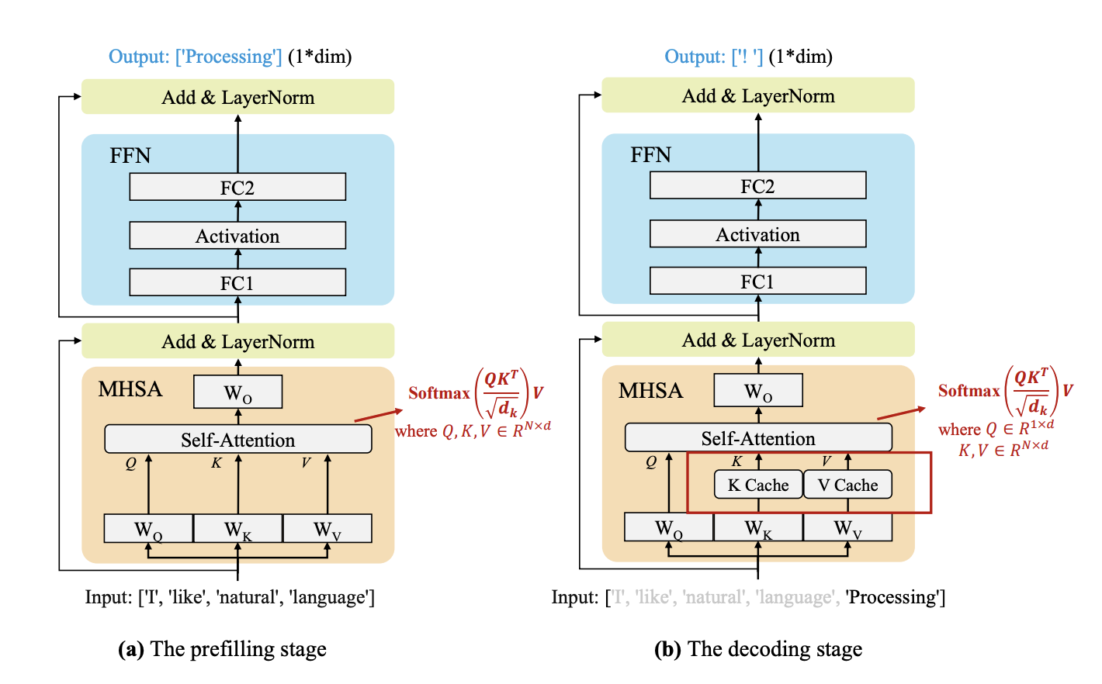
Motivation
Current LLMs follow an auto-regressive process, which separates into prefilling and decoding stages. ^{[1]}
Fig. 1 Demonstration of the prefilling stage (a) and decoding stage (b).
[1] A Survey on Efficient Inference for Large Language Models, arxiv 2024
Notes:
Current LLMs follow an auto-regressive process, which separates into prefilling and decoding stages.
As shown in Figure 1, prefilling stage calculates and stores the KV cache of the initial input tokens, and generates the first output token.
And decoding stage generates the output tokens one by one with the KV cache, and then updates it with the KV pairs of the newly generated token.

Slide 3
Motivation
When LLMs infer on long-context tasks, the KV cache occupies a lot of GPU memory and becomes a huge bottleneck.
Input
Output
Task
KV Cache Compression
(a)
Short
Short
Conventional QA
No Need
Long-form QA, Sentence retrieve
(b)
Long
Short
Prefilling
Long-form Generation
(c)
Short
Long
Decoding
(d)
Long
Long
LongGenBench
Prefilling + Decoding
Notes:
When LLMs infer on long-context tasks, the KV cache consumes a lot of GPU memory and becomes a huge limitation.
If we group tasks based on the length of the input prompt and output, we can divide them into four types:
Short input, short output, like common QA task
Long input, short output, like Long-form QA, Sentence retrieve task
Short input, long output, like Long-form Generation or current reasoning models often have very long reasoning contents
Long input, long output, like LongGenBench, I will introduce it later
only the first type doesn’t require KV cache compression.
For the other three types, the KV cache may be large from the beginning due to the long input, or may increase during the decoding stage.
In particular, type four, long input and long output, is most memory-intensive, and is the focus of our work.

Slide 4
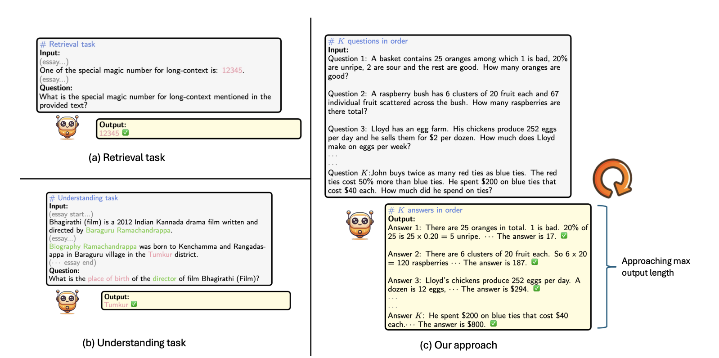
Motivation
LongGenBench is a benchmark specifically designed for multi-question answering tasks ^{[2]}. In these tasks, a single input contains multiple questions, and the model must answer each one sequentially.
Fig. 2 Illustrations of previous long-context benchmarks and LongGenBench.
[2] LongGenBench: Long-context Generation Benchmark, EMNLP 2024
Notes:
LongGenBench is a benchmark specifically designed for multi-question answering tasks. In this benchmark, a single input has multiple questions, and the model must answer each one in order. It develop the GSMeightK and CSQA task. This is an example of GSMeightK plus.

Slide 5
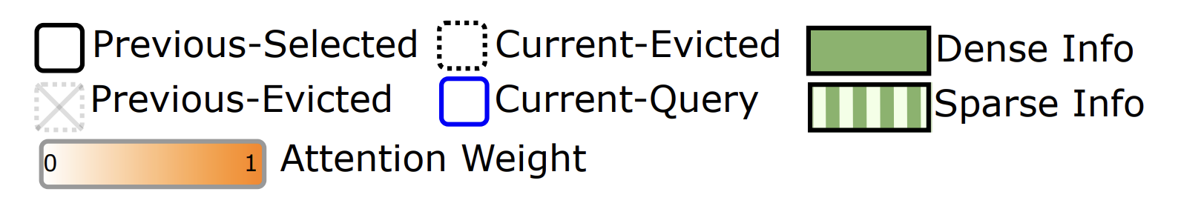
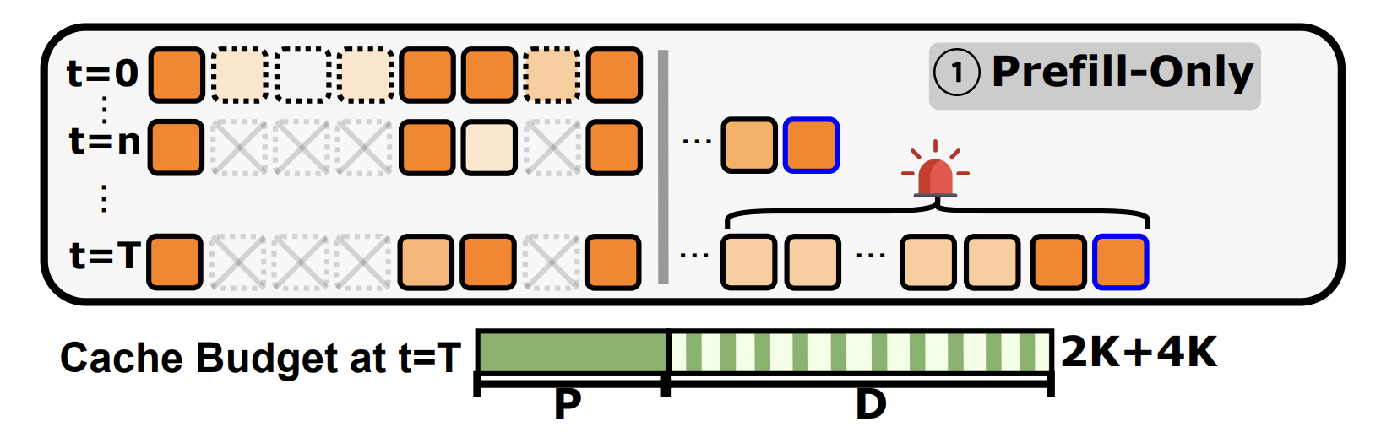
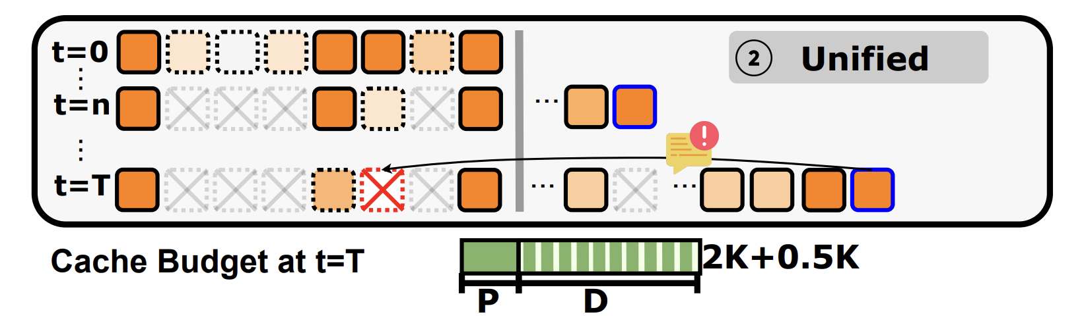
Motivation
“Heavy hitters” refer to the KV cache of pivotal tokens, a small subset of the entire KV cache, that effectively captures the critical information.^{[3]}
Previous methods fall into two categories:
(1) The Prefill-Only compression method ➡️ memory pressure for long outputs
(2) The Unified compression method ➡️ fine-grained content eviction
Fig. 3 (a) The Prefill-Only Compression method,
Fig. 3 (b) The Unified Compression method
[3] H2O: Heavy-Hitter Oracle for Efficient Generative Inference of Large Language Models, NeurIPS 2023
Notes:
"Heavy hitters" are important tokens in the KV cache. They make up a small part of the cache but have high attention scores. A greedy algorithm is used to find and keep them, so the model can focus on the most useful information.
In inference perspective, previous works typically fall into two categories. First, prefilling-only methods only compress the input side, which works well when outputs are short, but when the output is long, the KV cache is still large.
Second, unified methods compress both stages together, but may evict the wrong tokens due to the deviation of original heavy hitters, especially the important parts from input, in particular, on LongGenBench.

Slide 6
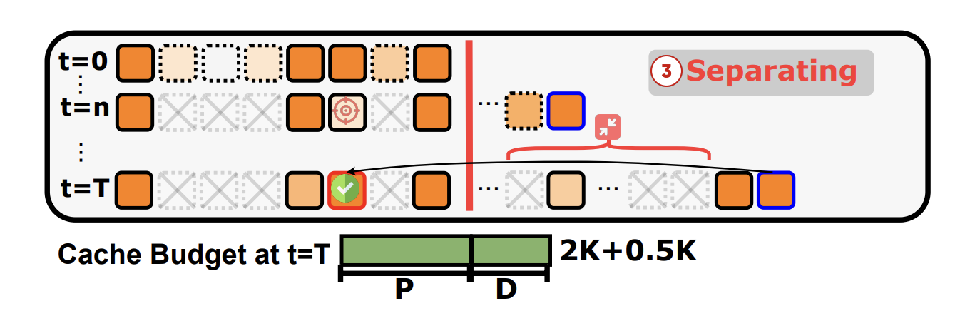
Separating the Prefill and Decoding Phases
Solutions: SCOPE, a simple yet efficient framework that Separately performs KV Cache Optimization during the Prefill and dEcoding phases.
Prefill Phase: Efficiently preserves essential information in the KV cache during prefilling.
Decoding Phase: Enables optimized allocation of KV cache generated during decoding.
Fig. 3 (c) Separating the prefill and decoding phases
Notes:
So, our idea is to treat prefilling and decoding separately. In the prefilling stage, we preserve import compressed KV cache that are critical for understanding the input. Then in decoding, we manage the cache dynamically to keep relevant context for future tokens.
This is the key idea behind SCOPE, our proposed framework.

Slide 7
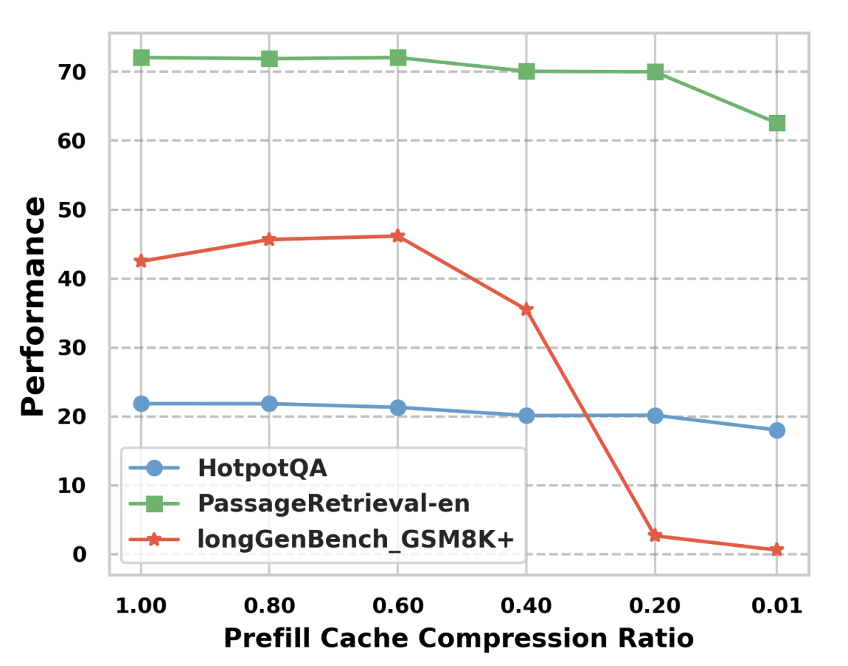
Pilot Observation: KV Cache in Inference Perspective
Prefill Stage
The 20% compression rate during the prefill phase resulted in nearly 95% degradation in accuracy on the GSM8k+ task within LONGGENBENCH.
Fig. 4 (a) Performances across various compression ratios during the prefill phase on three tasks under the full decoding cache condition.
Notes:
Two pilot observations led to this design.
First,a task on LonGenBench accuracy drops by ninety five% while traditional tasks, like HotpotQA or sentence retrieve task still have good performance when we preserve twenty% KV cache generated in prefilling stage.
This leads to compressing too much during prefilling may hurt context understanding.

Slide 8
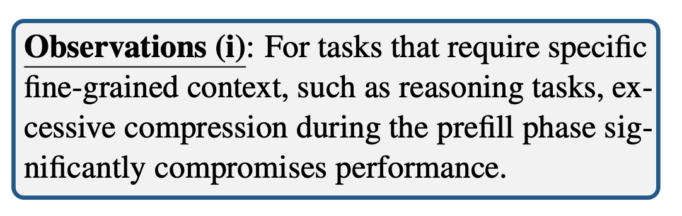
Pilot Observation: KV Cache in Inference Perspective
Prefill Stage
The 20% compression rate during the prefill phase resulted in nearly 95% degradation in accuracy on the GSM8k+ task within LONGGENBENCH.
Fig. 4 (a) Performances across various compression ratios during the prefill phase on three tasks under the full decoding cache condition.
Notes:
We can get the first observation:
For tasks that require specific fine-grained context, excessive compression during the prefilling stage can seriously hurt performance.

Slide 9
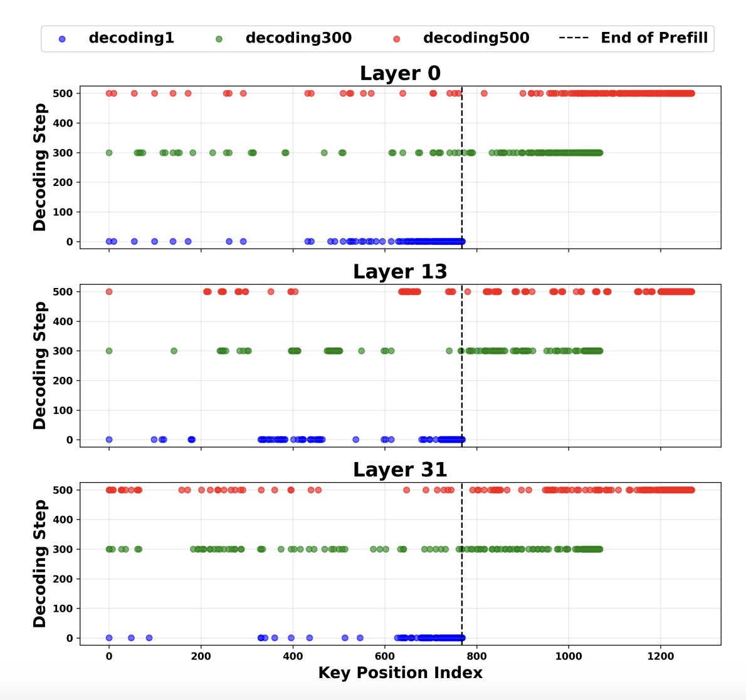
Pilot Observation: KV Cache in Inference Perspective
Decoding Stage
Across all three layers, the retained heavy hitters predominantly originate from the KV cache generated during the decoding phase.
Fig. 4 (b) Position distribution of the heavy hitters, selected by top 15% attention scores, at decoding steps 1, 300, and 500 across layers 0, 13, and 31.
Notes:
Second, during the decoding stage, across all three layers, high, middle, low, the retained heavy hitters mainly come from the KV cache generated during decoding.

Slide 10
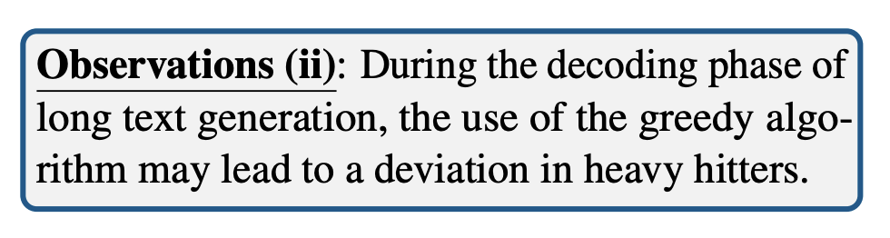
Pilot Observation: KV Cache in Inference Perspective
Decoding Stage
Across all three layers, the retained heavy hitters predominantly originate from the KV cache generated during the decoding phase.
Fig. 4 (b) Position distribution of the heavy hitters, selected by top 15% attention scores, at decoding steps 1, 300, and 500 across layers 0, 13, and 31.
Notes:
We can get second observation:
During the decoding stage of long text generation, the use of the greedy algorithm may lead to a deviation in heavy hitters.

Slide 11
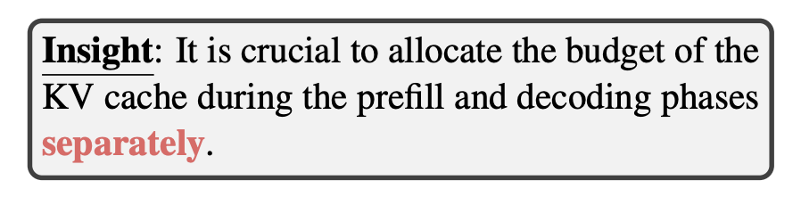
Pilot Observation: KV Cache Budget Reallocation
Notes:
The two insights guided our strategy.
It is crucial to allocate the budget of the KV cache during the prefilling and decoding stages separately.
So, we keep all key input information by not evicting the compressed KV cache from prefilling, and use our proposed method to keep only the useful parts of the decoding cache. This strategy is simple but very effective.

Slide 12
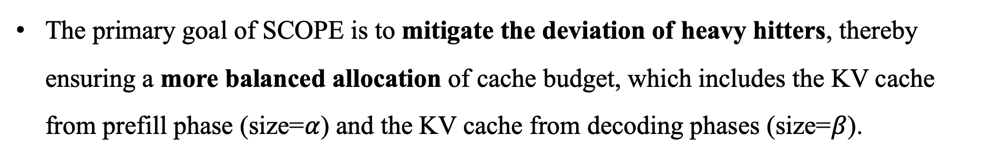


Methods
The primary goal of SCOPE is to mitigate the deviation of heavy hitters, thereby ensuring a more balanced allocation of cache budget, which includes the KV cache from prefill phase (size=$α$) and the KV cache from decoding phases (size=$β$).
Prefilling Stage
prefill essential history window $α_{1}$
prefill local window$α_{2}$
retain KV with higher attention weights for the current query
ensure both contextual continuity and retention of attention
We reserved all compressed KV Cache generated during the prefill phase.
Notes:
Now let’s look at the details of our framework.
In the prefilling stage, the most effective and commonly used method, as shown by early works, two import hyperparameters $α_{1}$ and $α_{2}$ are introduced, where $α_{1}$ represents the length of prefilling essential history window and $α_{2}$ represents the length of prefilling local window during the prefilling stage.

Slide 13

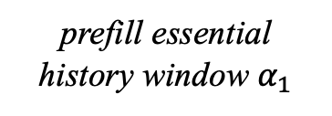
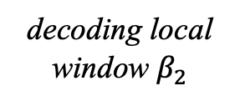
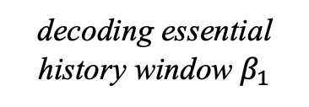

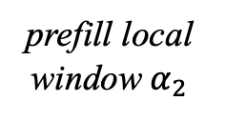
Methods
Decoding Stage
the KV cache from prefill phase (size=$α$)
the KV cache from decoding phase (size=$β$)
prefill essential history window $α_{1}$
prefill local window$α_{2}$
decoding essential history window$β_{1}$
decoding local window$β_{2}$
help identity the position of the current prediction
store global information strongly correlated with previous tokens
Reserved all compressed KV Cache generated during the prefill phase.
Update KV Cache during the decoding phase.
Notes:
We reserved all compressed KV Cache generated during the prefilling stage.
In the decoding stage, we update the cache step by step and similar to the prefilling stage, we also introduce two hyperparameters, $β_{1}$ and $β_{2}$.
decoding essential history window $β_{1}$ is to help know the position of the current prediction
decoding local window $β_{2}$ is to store global information strongly linked with previous tokens

Slide 14
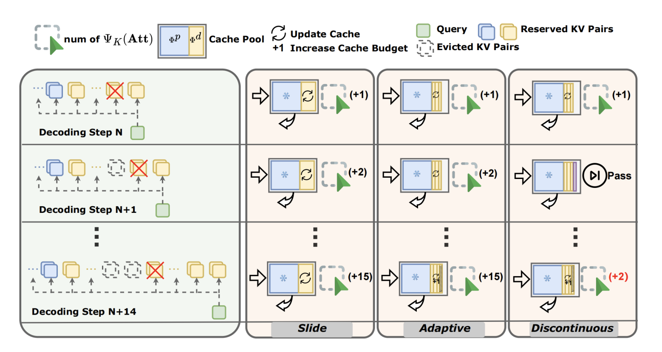
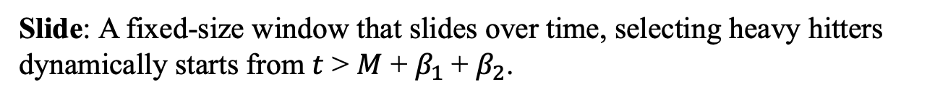
Methods
Decoding Stage
Slide: A fixed-size window that slides over time, selecting heavy hitters dynamically starts from $t$ > $M$ + $β_{1}$+ $β_{2}$.
Notes:
Here, we propose three strategies for the decoding stage:
Slide: A fixed-size window that slides over time, selecting heavy hitters dynamically by two introduced, $β_{1}$ and $β_{2}$.

Slide 15
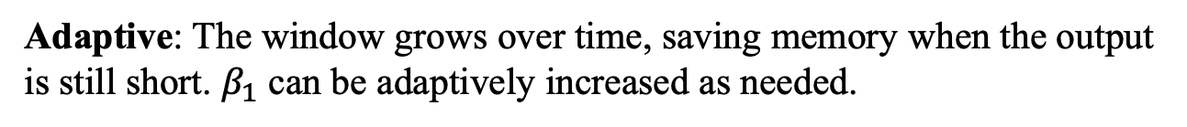
Methods
Decoding Stage
Adaptive: The window grows over time, saving memory when the output is still short. $β_{1}$ can be adaptively increased as needed.
Notes:
Adaptive: The window grows over time, saving memory when the output is still short. $β_{1}$ can be adaptively increased as needed.

Slide 16
Methods
Decoding Stage
Discontinuous: The selection operation can be reduced, reduces computation by skipping unnecessary updates.
Notes:
Discontinuous: The selection operation can be reduced, reduces computation by skipping unnecessary updates.
These strategies allow us to compress the decoding cache without hurt model understanding.

Slide 17
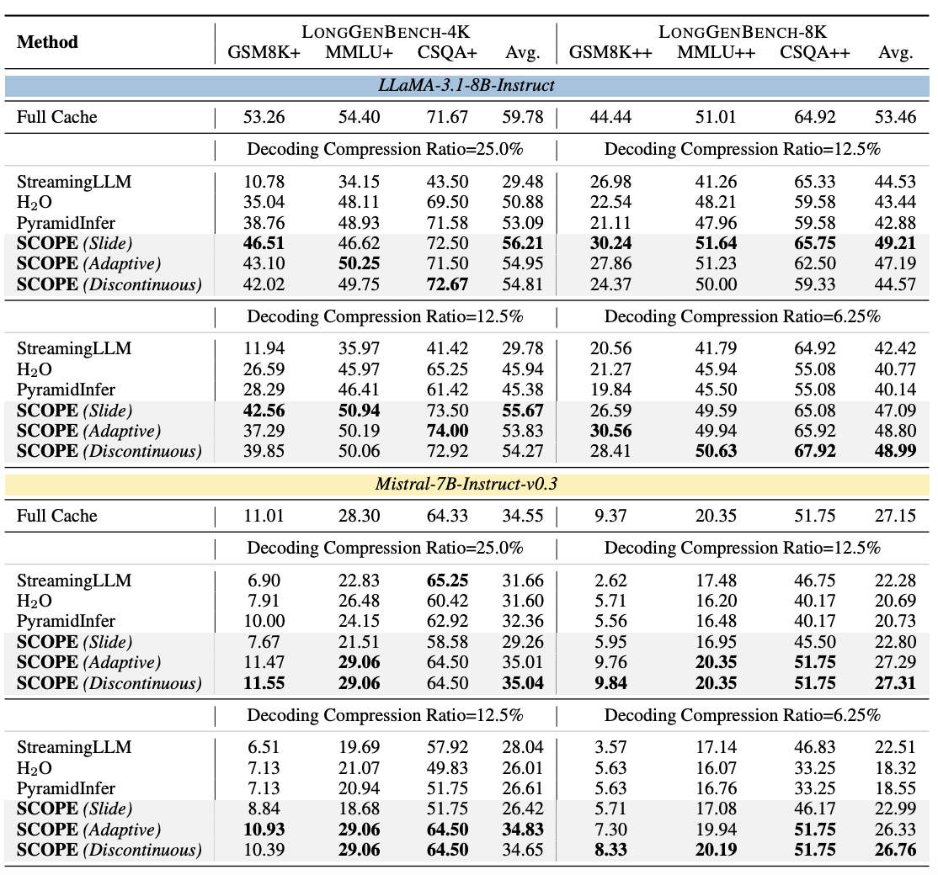
Experimental Results
On the challenge tasks, SCOPE highlights the importance of preserving the KV cache generated during the prefill process, while other compression methods lead to marked performance degradation.
Notes:
We evaluate SCOPE on LONGGENBENCH.
Our results show that under the same compression rate, SCOPE consistently outperforms baselines like StreamingLLM, H2O, and other baselines.
On the GSMeightK plus task, even with only thirty five% of the full cache size, we achieve performance comparable to full cache.

Slide 18
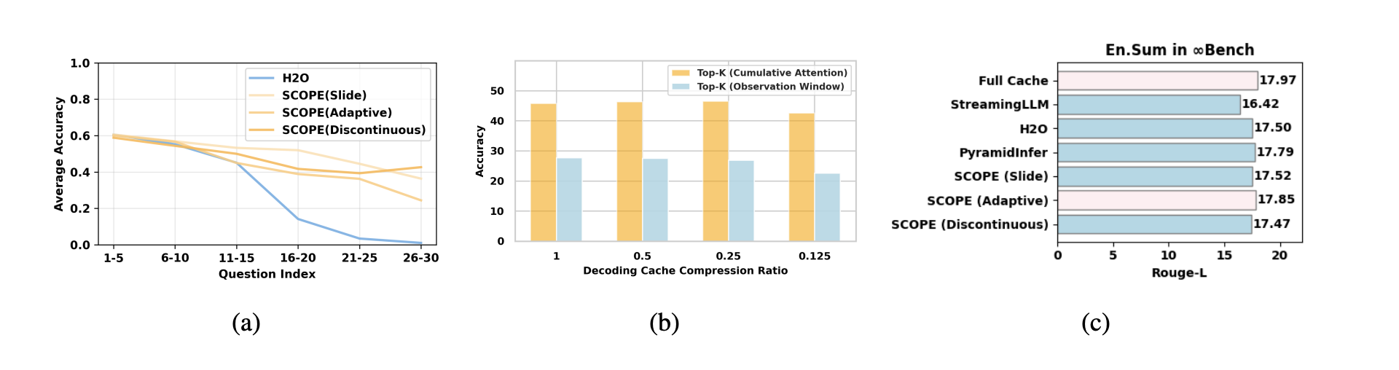
Experimental Results
(a) Accuracy distribution of different question positions. (b) Accuracy across different cache compression ratios during the decoding phase using two Tok-K selection algorithms. (c) Results on En.Sum.
Effectiveness of preserving the prefill KV cache.
Traditional tasks may also be suited to the separation of prefill-decoding KV cache budget allocation.
Notes:
We also do some analysis experiments, the results show the effectiveness of preserving the prefill KV cache and the generalization of our methods.

Slide 19




Conclusion and Future Work
We observe that excessive compression during the prefill phase harms reasoning capabilities while the deviation of heavy hitters during decoding;
We propose SCOPE, a framework that optimizes KV cache usage for long-context generation in LLMs.
Future Work: Focus on improving performance in reasoning-intensive tasks and exploring algorithm-hardware co-design for more efficient deployment.
Github
Paper
Notes:
In summary:
We propose SCOPE, a framework that separates prefilling and decoding stages for better KV cache management. It preserves important input information and dynamically allocates decoding cache using efficient strategies.
In future, we aim to:
Focus on improving performance in reasoning-intensive tasks
And explore hardware-algorithm co-design to push efficiency in real world.
Thank you for your attention!
Hyperparameter:
We conduct the comprehensive analysis on hyperparameters. You can check our paper’s experiments part and appendix.
The current result show:
sixty% compression on prefilling stage and twenty-five percent compression on decoding stage can achieve good enough results.
Why $β_{1}$ and $β_{2}$?
In LonGenBench, answer the current question needs to know the current position and answer this position’s answer.
$β_{2}$ is to store global information strongly correlated with previous tokens.
So maybe $α_{1}$ is not important if $β_{2}$ can play a role in storing key information.
与h2o的区别
When we compare the previous works in inference perspective, the classification is based on their code implementation.
So for the first group, prefilling-only method, they don’t consider the KV cache during generation compress.
The second group, unified method, when outputs are very long or current reasoning model, like have very long reasoning contents, the current algorithm of selecting KV cache may lead to the deviation of heavy hitters.
I think the reason behind these limitation is the current evaluated benchmark in KV cache compression field, they don’t focus on the tasks which have very long context or reasoning content.
Maybe such benchmark designed to evaluate the KV cache compression is valuable and interesting.
I think our work is a small step to solve the problem about KV cache compression during the decoding.
Due to the token-by-token generation LLM nature, dynamically select truly useful KV cache is challenging, because you never now whether the importance of KV cache at the next step.
Furthermore, in real world application, the hyperparameters and how to align with flash attention 1 or 2, how to integrate vllm, are important and we really need more hardware-algorithm co-design.
And our framework are motivated the insights from the observation, the dpsk’s proposed native sparse attention, don’t need predefined sparse patterns, just let models to learn the sparse pattern.
It maybe interesting and more elegent.

